Slide 1
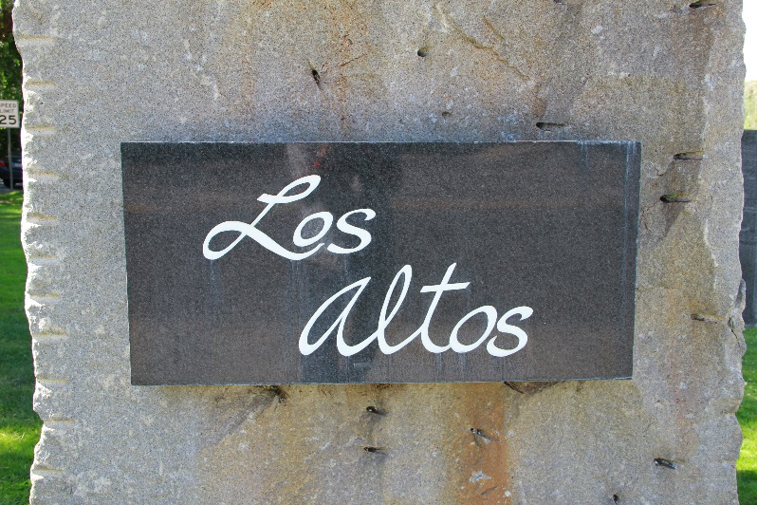
Fiscal Year 2018/19
Mid-Year Financial Update
February 27, 2018
Notes:
Honorable Mayor and Members of the City Council – introduce myself
I’d like to begin this evening by giving a brief overview of the City budget to provide context to our new councilmembers as well as to members of the public
City adopts two separate budgets – combined into one budget documents
Operating Budget which are the day-to day costs to run the City and include City personnel costs and services and supplies. The proposed budget provides a two-year financial plan but appropriations will only be made for the first year
Capital Improvement Budget are where the City budgets for major capital investments in excess of $10K which includes capital projects and major equipment purchases. The proposed budget provides a five-year work program for planning purposes only – appropriations are made only for the first year

Slide 2
General Fund Mid-Year Highlights
FY 2018/19 Revenue Budget of $39.8 million
$16.4M at Mid-Year
41% collected as of 12/31/18
Increase of $689K from prior year
FY 2018/19 Expenditure Budget of $38.0 million
$17.4 M at Mid-Year
46% spent as of 12/31/18
Increase of $1.1M over same time last year
Notes:
Honorable Mayor and Members of the City Council – introduce myself
I’d like to begin this evening by giving a brief overview of the City budget to provide context to our new councilmembers as well as to members of the public
City adopts two separate budgets – combined into one budget documents
Operating Budget which are the day-to day costs to run the City and include City personnel costs and services and supplies. The proposed budget provides a two-year financial plan but appropriations will only be made for the first year
Capital Improvement Budget are where the City budgets for major capital investments in excess of $10K which includes capital projects and major equipment purchases. The proposed budget provides a five-year work program for planning purposes only – appropriations are made only for the first year

Slide 3
Revenue Trends
Mid-Year FY18/19 vs. Prior Year
Notes:
The 2015/16 proposed General Fund revenue budget is set at $35.8 million and $36.4 million in 2016/17.
Of this total amount, over ¾’s comes from taxes – and 50% of the entire General Fund budget comes from Property Tax.
Fees represent 22.5% of the remaining budget and includes department generated fees, franchise fees, and administrative allocations.
The remaining revenue sources in the General Fund budget includes investment income, transfer in, and one-time revenues.
A major source of one-time revenue is Excess ERAF revenue – ERAF is a move by the State in the 1990’s that shifted property tax dollars away from cities to fund education in each county (saves State General Fund). There are a handful of counties in which the amount of property tax diverted into the county ERAF fund has exceeded the amount needed under the state’s education funding formulas and is therefore returned to the City’s proportionally.
Excess ERAF is best treated as one-time revenue due to the lack of predictability as well as a number of recent attempts to divert Excess ERAF funds elsewhere by State legislators.
Transfers in to the General Fund reduced by $184K due to recommended elimination of Gas Tax transfer to fund Streets Operations

Slide 4
Expenditure Trends
Mid-Year FY18/19 vs. Prior Year
Notes:
The 2015/16 proposed General Fund revenue budget is set at $35.8 million and $36.4 million in 2016/17.
Of this total amount, over ¾’s comes from taxes – and 50% of the entire General Fund budget comes from Property Tax.
Fees represent 22.5% of the remaining budget and includes department generated fees, franchise fees, and administrative allocations.
The remaining revenue sources in the General Fund budget includes investment income, transfer in, and one-time revenues.
A major source of one-time revenue is Excess ERAF revenue – ERAF is a move by the State in the 1990’s that shifted property tax dollars away from cities to fund education in each county (saves State General Fund). There are a handful of counties in which the amount of property tax diverted into the county ERAF fund has exceeded the amount needed under the state’s education funding formulas and is therefore returned to the City’s proportionally.
Excess ERAF is best treated as one-time revenue due to the lack of predictability as well as a number of recent attempts to divert Excess ERAF funds elsewhere by State legislators.
Transfers in to the General Fund reduced by $184K due to recommended elimination of Gas Tax transfer to fund Streets Operations

Slide 5
SEWER AND SOLID WASTE
Mid-Year FY18/19 vs. Prior Year
Notes:
The 2015/16 proposed General Fund revenue budget is set at $35.8 million and $36.4 million in 2016/17.
Of this total amount, over ¾’s comes from taxes – and 50% of the entire General Fund budget comes from Property Tax.
Fees represent 22.5% of the remaining budget and includes department generated fees, franchise fees, and administrative allocations.
The remaining revenue sources in the General Fund budget includes investment income, transfer in, and one-time revenues.
A major source of one-time revenue is Excess ERAF revenue – ERAF is a move by the State in the 1990’s that shifted property tax dollars away from cities to fund education in each county (saves State General Fund). There are a handful of counties in which the amount of property tax diverted into the county ERAF fund has exceeded the amount needed under the state’s education funding formulas and is therefore returned to the City’s proportionally.
Excess ERAF is best treated as one-time revenue due to the lack of predictability as well as a number of recent attempts to divert Excess ERAF funds elsewhere by State legislators.
Transfers in to the General Fund reduced by $184K due to recommended elimination of Gas Tax transfer to fund Streets Operations

Slide 6
FY18/19 Mid-Year Adjustments
Operating Budget (general Fund)
Administrative Services
  Cost Allocation Plan and User Fee Study ($40K)
Police Department
  One additional School Resource Officer ($40K, $160K ongoing)
Engineering Services Department
  Professional Services Increase ($150K)
City Attorney
  Legal Expense Increase ($500K)
Updated Salary Schedule

Slide 7
FY18/19 Mid-Year Adjustments
Equipment Replacement Fund
Police Department
Vehicle Modifications ($30K)
K-9 Vehicle
Maintenance Services
Crack Sealer ($75K)

Slide 8
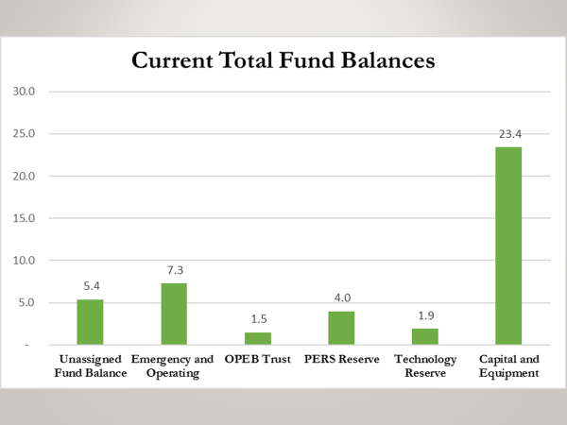
Allocation of Unassigned Fund Balance

Slide 9
Allocation of Unassigned Fund Balance

Slide 10
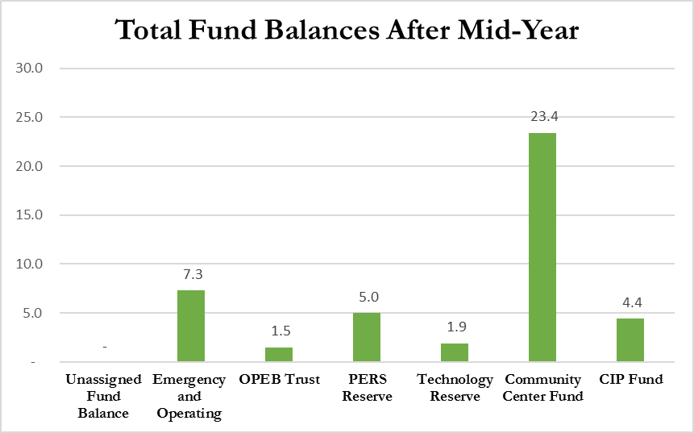

Slide 11
NEXT steps
Prepare FY 2020 and FY 2021 Operating Budgets
Prioritization of CIP projects for FY 2020-24
CalPERS unfunded liability payment plan
Community Center Project and funding
Storm Drain program funding
Other

